Slide 1
Woodview
Plan of Subdivision
Applications for Official Plan and Zoning By-law Amendment
Part of Lots 6 & 7, Concession 6, Burleigh Ward, Township of North Kawartha
Statutory Public Meeting – June 2, 2026

Slide 2
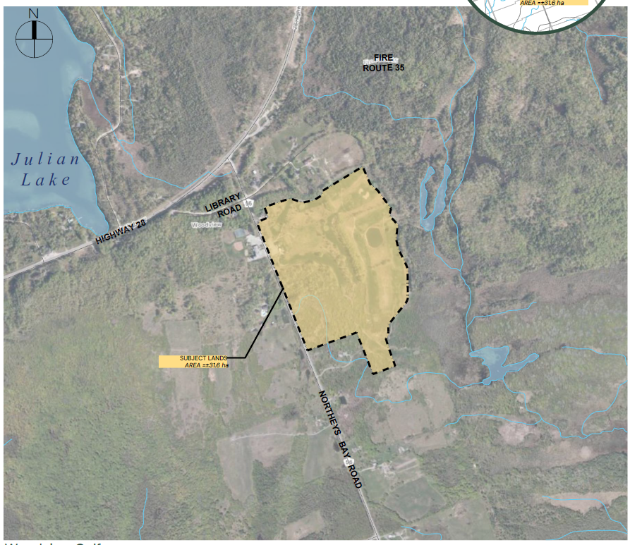
Site Location
Woodview Plan of Subdivision
65 Northey’s Bay Road (Part of Lots 6 & 7, Concession 6, Southern Division, Burleigh Ward.
Approximately 400 metres south of the intersection of Highway 28 and Northey’s Bay Road.
West of site: Woodview Community Centre and Library, EMS Station 1
Residential lands to the north, Rural and Rural Residential immediately south, and Rural lands to the east.
Approximately 1/3 of the property is located within the Woodview Hamlet Area.

Slide 3
Proposal
Woodview Plan of Subdivision
Property owner and applicant: Eric and Diane Challenger
Previously owned and operated the Woodview Golf Course (9-hole) on the site for 10 years.
Proposal: 59-lot Plan of Subdivision:
  58 residential lots for single detached dwellings (with ARUs) (min. 3,000 sq. m each)
  1 general commercial lot at the new intersection with Northey’s Bay Road.
  Additional Environmental Protection blocks
  Stormwater pond block
Internal road network to be assumed by the Township.

Slide 4
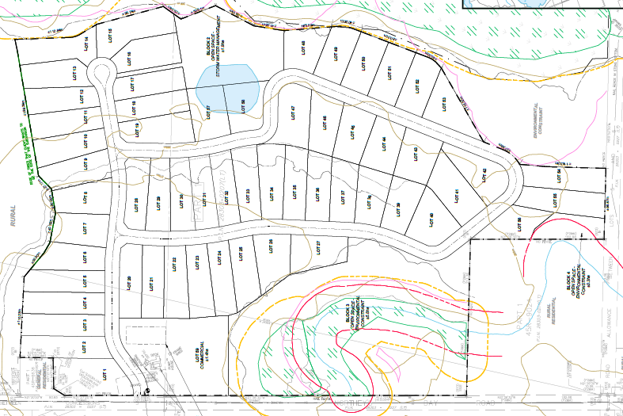

Slide 5
Required Applications
Woodview Plan of Subdivision
The property is partially located within the Woodview Hamlet Area in the County of Peterborough Official Plan. The balance of the property is designated Rural.
An Official Plan Amendment (OPA) is required to adjust the Hamlet Area and redesignate the Rural lands in order to permit the entire development.
A Zoning By-law Amendment (ZBA) is required to rezone the lands from the Rural-Exception 124 (RU-124) to the Residential (R) Zone, General Commercial (C) Zone, Open Space (OS) Zone and Environmental Constraint (EC) Zone.
Plan of Subdivision application is required to subdivide the land.

Slide 6
Supporting Studies
Woodview Plan of Subdivision
Planning Justification Report
Hydrogeological Assessment
Geotechnical Investigation
Preliminary Stormwater Management Report
Environmental Impact Study
Phase 1 Environmental Assessment
Stage 1 & 2 Archaeological Assessment
Traffic Impact Study
*all have received sign-off from County peer-review
Consultation with Curve Lake First Nation has been undertaken. Representatives of CLFN have visited the site and met with the landowners and did not have any concerns.

Slide 7
Additional Background
Woodview Plan of Subdivision
In 2021 the applicant began the process to prepare and submit applications in support of a 59-lot plan of subdivision.
Engaged a number of technical consultants to complete the required studies over several years.
During this time, the County was in the process of updating the Official Plan – NK recommended that the entire golf course be included within the Woodview Hamlet Area as part of a growth management exercise and in adopted 2022 County OP.
The subject property has been identified by the Township and County for low density residential and commercial growth in the Hamlet. The subject OPA simply implements this change ahead of the approval of the new OP.
County OP has been adopted but not yet approved by the Province – however, 2024 PPS permits Settlement Area adjustments without the need for an MCR.

Slide 8
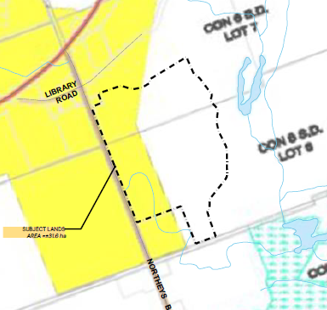
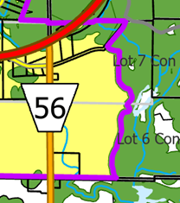
Current County OP
New County OP

Slide 9
Concerns
Woodview Plan of Subdivision
Impacts to Julian Lake:
the development is well outside of the MECP 300 metre assessment area for at-capacity lakes (585 metres).
There is no indication by the geologists that there will be groundwater impacts to the lake, based on the distance 585 metres (well beyond the typical study area)
Impacts to Groundwater
Hydrogeological Assessment – as verified by professional peer reviewers – concludes that there will be no negative impacts to groundwater quantity and quality
This includes adjacent wells
Groundwater monitoring will be required as a draft plan condition as a precaution (typical for a privately-serviced subdivision)

Slide 10
Concerns
Woodview Plan of Subdivision
Traffic:
Traffic Impact Study was competed with sign-off provided by County peer reviewers.
Conclusion: the intersection of 28/Northey’s Bay Road has sufficient capacity, as does the Northey’s Bay Road, to accommodate the development.
Impact on Character of Area
Scale of development – the lots are of a typical rural residential size (0.75 acres to 1.25 acres)
The site is located in a Hamlet Settlement Area where development of this scale (low density, single detached dwellings on private services) is intended to be located.

Slide 11
Concerns
Woodview Plan of Subdivision
The Environment
An Environmental Impact Study was undertaken that thoroughly reviewed the site and immediate area.
All natural heritage features, which include wetlands, potential habitat of endangered and threatened species, and fish habitat, will be protected on the site.
The features will be undisturbed and designated and zoned Environmental Protection/Environmental Constraint to ensure their long-term protection.
County peer reviewers provided sign-off on the EIS.

Slide 12
Recommendations
Woodview Plan of Subdivision
The recommendations of the Planning Consultant’s report requests that Council set a date for a future recommendation report that will summarize the comments received and provide a critique of the application.
We respectfully request that Council consider the applications at the next Council meeting (June 16th) for approval.
Based on our review of the public comments, there have been no technical or planning issues raised that have not already been addressed in the existing materials.

Slide 13
Summary
Woodview Plan of Subdivision
The proposed OPA, ZBA and Plan of Subdivision are consistent with the PPS and conform to the County Official Plan (both current and adopted).
The proposed development is not premature – the site has been identified by the Township for hamlet (both residential and commercial) development.
The proposal does not require upgrades to existing roads or infrastructure.
The proposal will not negatively impact the natural environment or groundwater resources.
The proposed development represents good planning and should be approved.

Slide 14

Woodview Plan of Subdivision
J. Kent Randall, B.E.S., MCIP, RPP
Principal Planner
EcoVue Consulting Services Inc.
705-876-8340
krandall@ecovueconsulting.com

