Slide 1
Chandos Lake Boat Launch Signage

Slide 2
“CLEAN, DRAIN & DRY”
Clean, Drain, Dry boating signs are crucial educational tools to stop the spread of aquatic invasive species (AIS), mandated in many regions.
They instruct boaters to remove debris/plants, drain all water, and dry gear to prevent spreading organisms like zebra mussels.
Key actions include removing plugs and inspecting trailers before leaving shore.
CLEAN: Remove all mud, plants, and debris from watercraft, trailers, and equipment (anchors, fishing gear) before leaving the shoreline.
DRAIN: Drain all water from bilges, motors, live wells, and bait buckets before driving away.
DRY: Dry all parts of the watercraft and equipment completely before entering a new body of water.

Slide 3
Key Information on Signage & Regulations
Legislation: As of 2022, in Ontario it is mandatory to remove plants, animals, and algae, and to pull all drain plugs, according to the Invasive Species Act and Regulations.
Message: Signs encourage washing boats on land away from storm drains and avoiding transporting live bait between water bodies.
Ordering Signs: In Ontario, free signs can be requested from the Invading Species Awareness Program for marinas and boat launches.

Slide 4
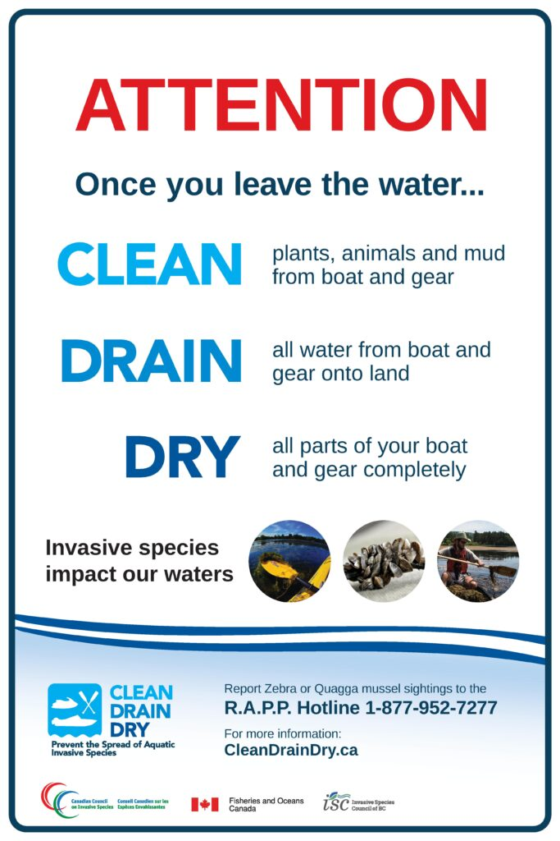
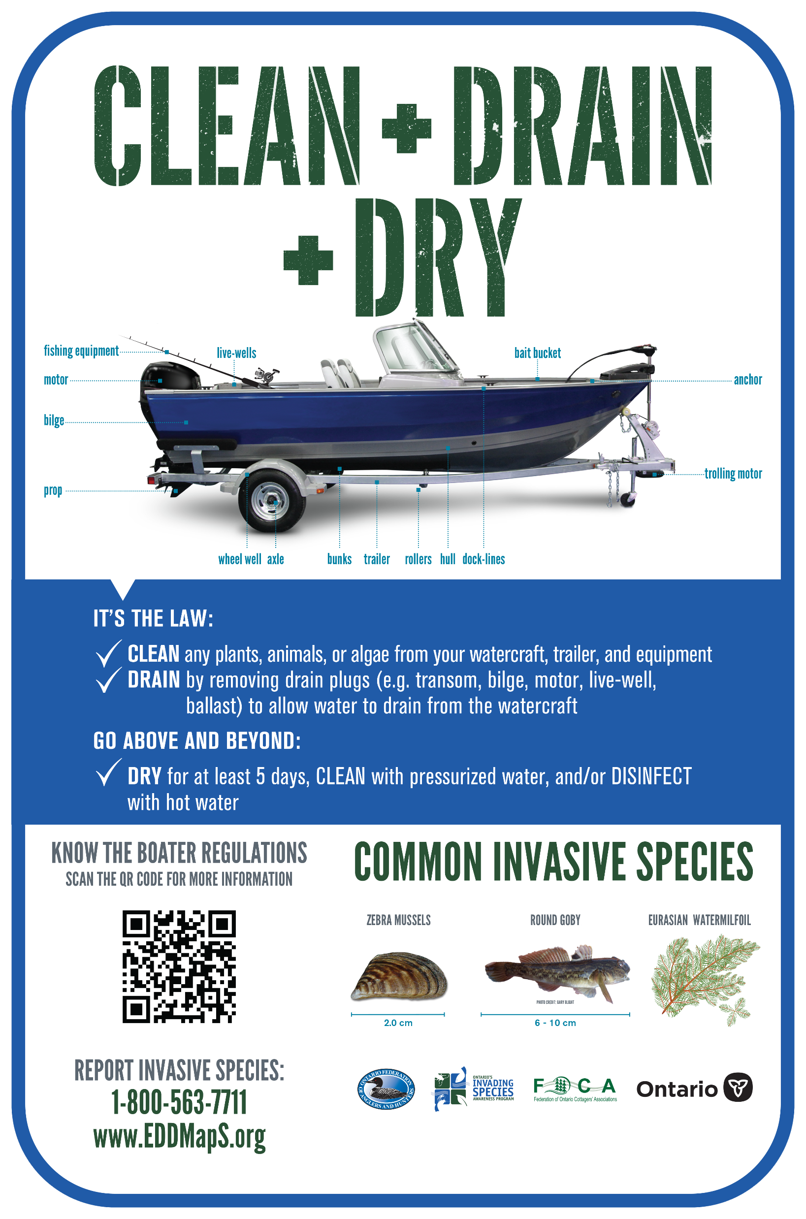

Slide 5
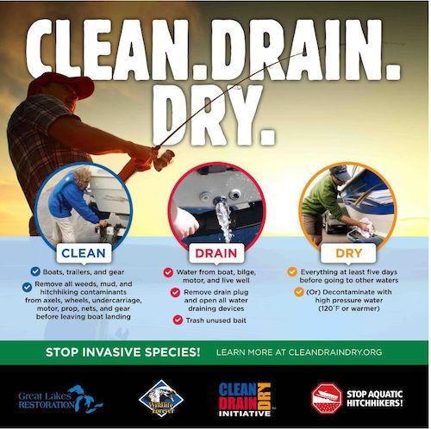
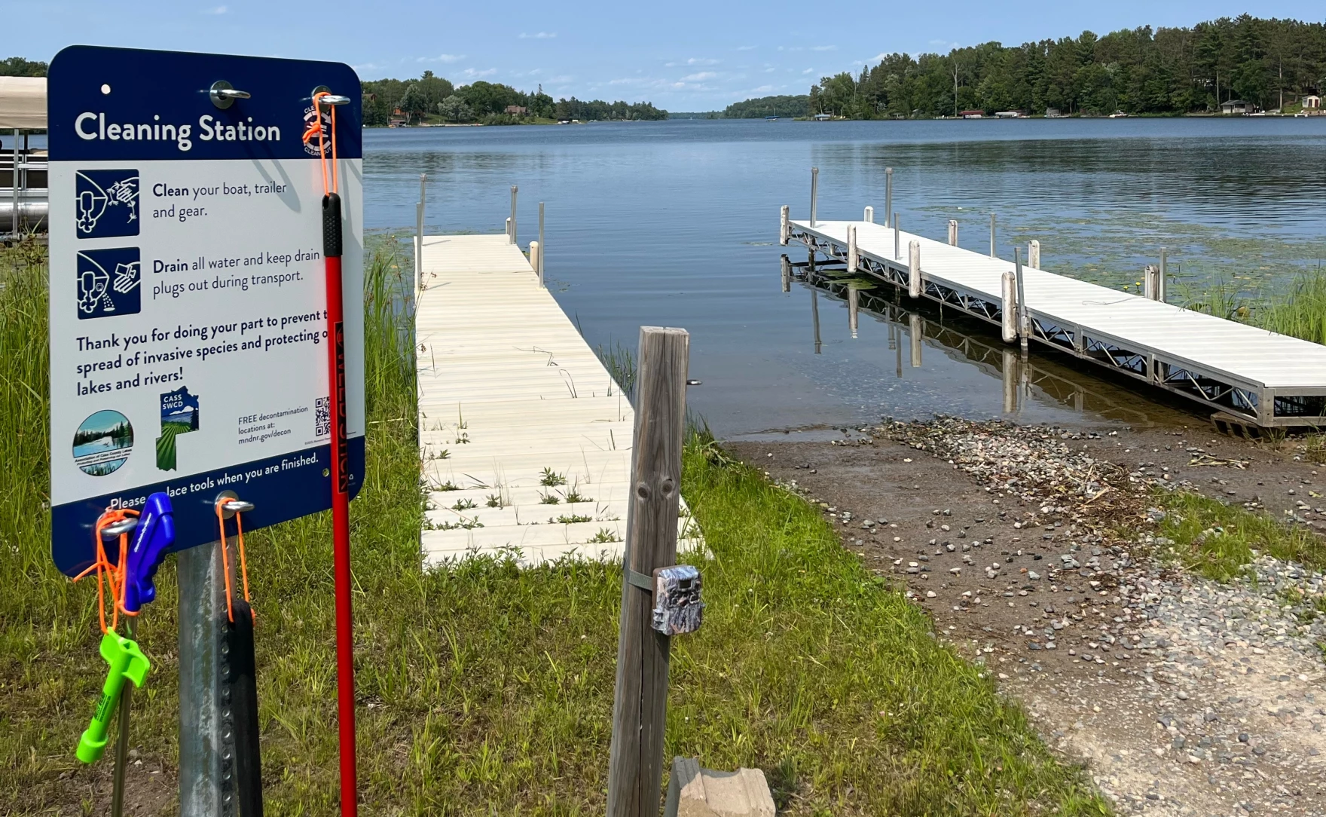

Slide 6
Chandos Lake CLPOA Boat Cleaning Station & Supporter Advertsing

Slide 7
